Slide 1
Forces and Energy
Concepts relating to Rube Goldberg machines

Slide 2
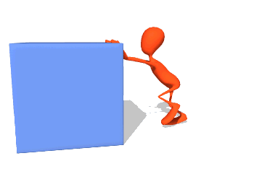
What is a Force?
A force is anything that pushes or pulls another object
PUSH
PULL

Slide 3
Which of the following is a force?
A light causes the room to become brighter
Magnets repel or attract each other
Earth’s gravity pulls us
down

Slide 4
Which of the following is a force?
A light causes the room to become brighter
Magnets repel or attract each other
Earth’s gravity pulls us
down
NOT A FORCE
PUSH OR PULL
PULL

Slide 5
What is Energy?
It is the ability to apply a force on another object

Slide 6
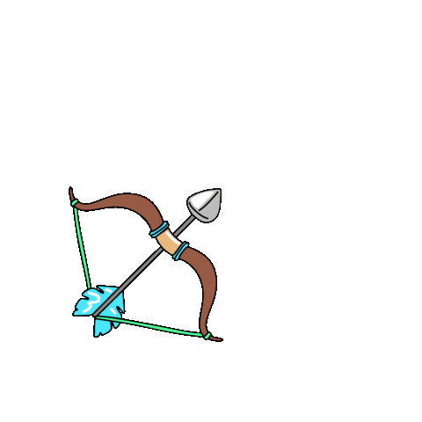
Kinetic Energy
Potential Energy
Energy of moving objects
Stored energy
A stretched arrow can apply a force after it is released
A rock on a cliff can fall down and exert a force on the ground below.
The car can collide and apply a force on another object

Slide 7
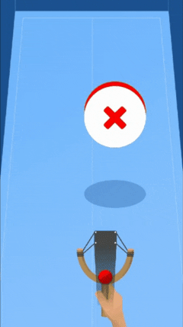
Energy can be transformed from one type to another
When the elastic is released, the potential energy stored in the elastic will cause the ball to move and have kinetic energy

Slide 8
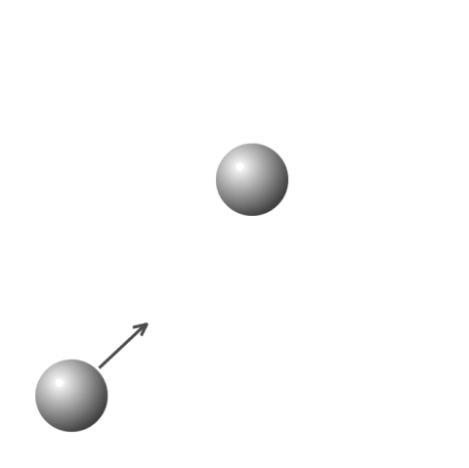
Energy can be transferred from one object to another
A moving ball can bump into another ball and cause it to move, this transfers kinetic energy

Slide 9
We Challenge You...
To remember these concepts when making your Rube Goldberg machine

